Slide 1

HOW TO Present Scientific data
L. Nelson Sanchez-Pinto, MD, MBI
PALSIS CRC
March 20th, 2023

Slide 2

Before we start, some context
This is a compendium of common best practices (but not all)
It mostly focuses on journal articles (but can be extrapolated)
It’s useful for data big and small (but biased towards bigger)
You can download this presentation + resources:
https://github.com/nsanchezpinto/Presenting-Scientific-Data

Slide 3
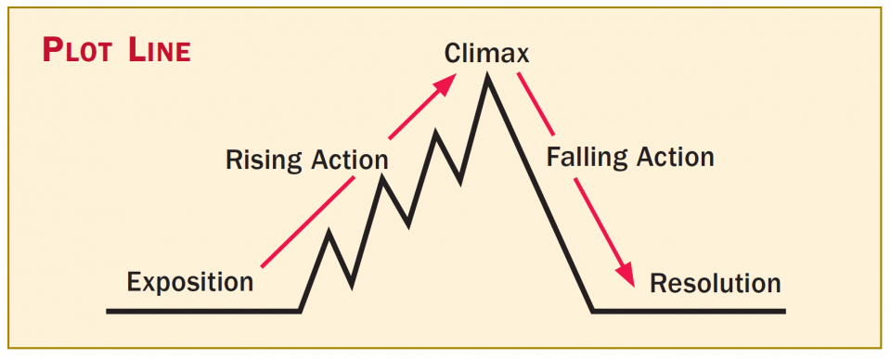
1. Tell a story with your data and provide context
Data talks and nobody walks!
Start general (set context) and then get specific (main finding)
Main finding(s)
Table 1
Sensitivity analyses
Methods
Secondary findings
Introduction
Discussion

Slide 4
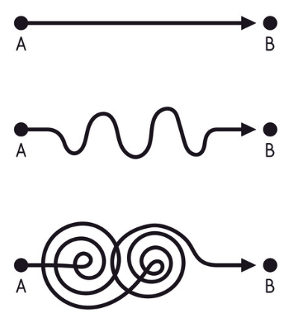
2. Keep it simple
What data is sufficient to tell your story?
Trim it down, but don’t take out important negative/refuting results.
Use the Supplement for the superreaders
In the main article, make sure you answer your research question (no more, no less)

Slide 5

3. Put different data where it belongs
Text is good for interpretation of data and contextualizing
Tables are good for showing precise/absolute numbers
Figures are good for showing proportions and trends
AVOID REPEATING THE SAME DATA
IN MORE THAN ONE PLACE

Slide 6


4. Data in text is tricky, but important
Provide interpretation, but not discussion nor viewpoints
Instead of:
“Before the implementation the length of stay was 5.4 days (IQR 4.2 - 6.5) and after the implementation it was 4.8 days (IQR 3.8-5.8), p<0.001.”
Use:
“Implementation was associated with a significant reduction in length of stay (Table X).”
But don’t use:
“Surprisingly, implementation was associated with a longer length of stay (Table X).”
Don’t qualify change (e.g. “increased after”) or differences (e.g. “higher than”) unless you prove it (i.e. it’s statistically significant)

Slide 7
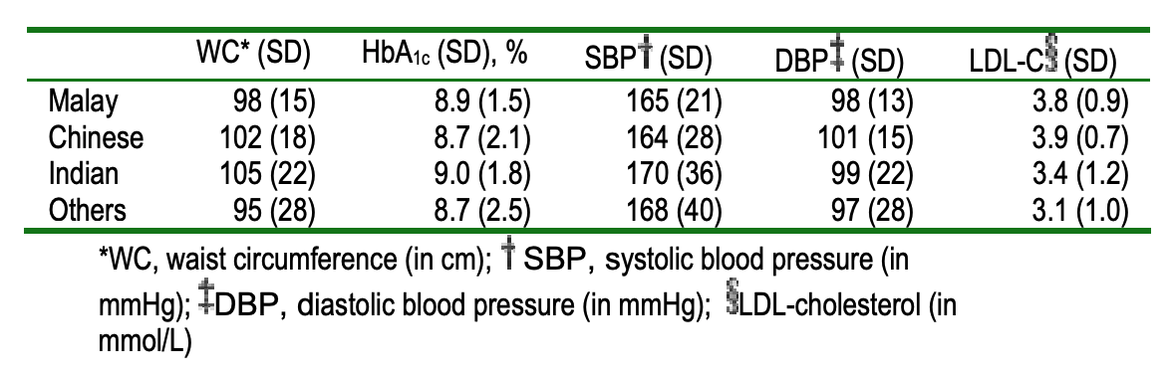
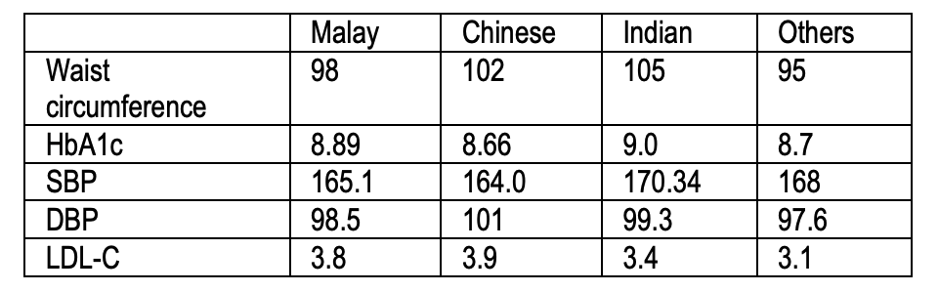
5. Tables are all about formatting
Table 1: Baseline waist circumference, HbA1c, Blood pressure and LDL-cholesterol level among Malay, Chinese, Indian and other groups
Table 1: Mean (SD) baseline diabetic metabolic parameters among different groups

Slide 8
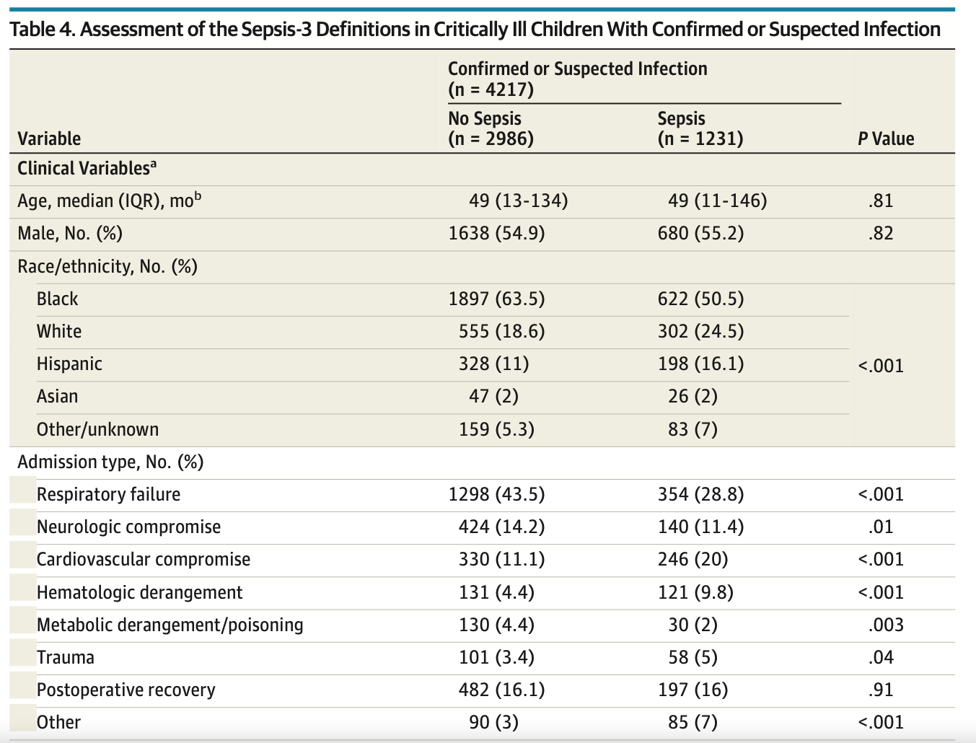
5. Tables are all about formatting

Slide 9
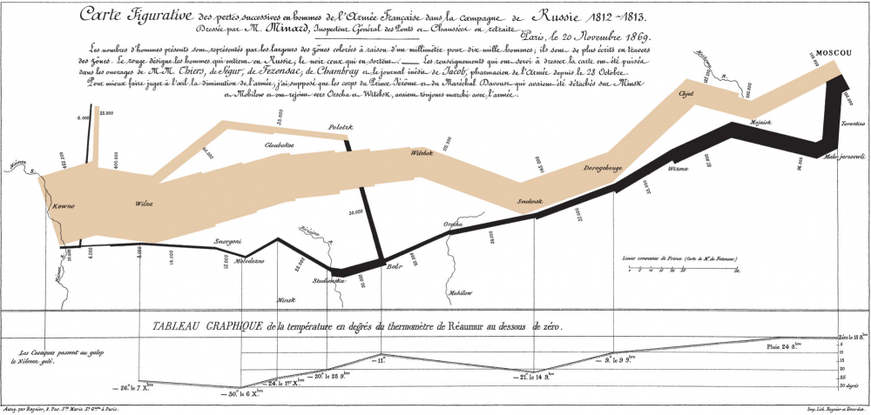
6. Figures convey information like no other medium

Slide 10
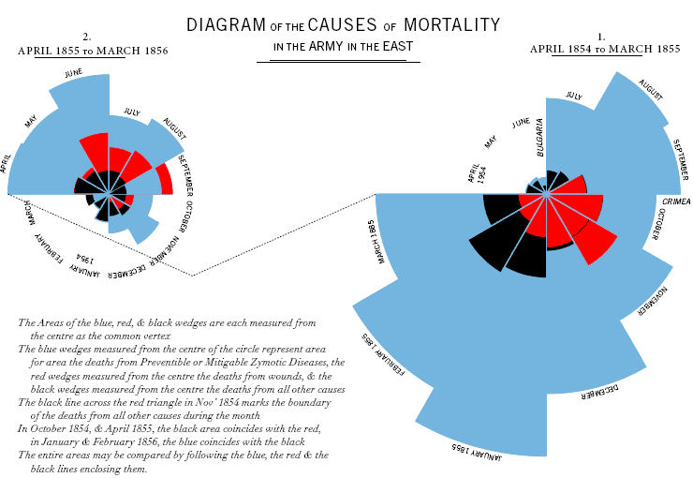
6. Figures convey information like no other medium

Slide 11

6. Figures convey information like no other medium

Slide 12
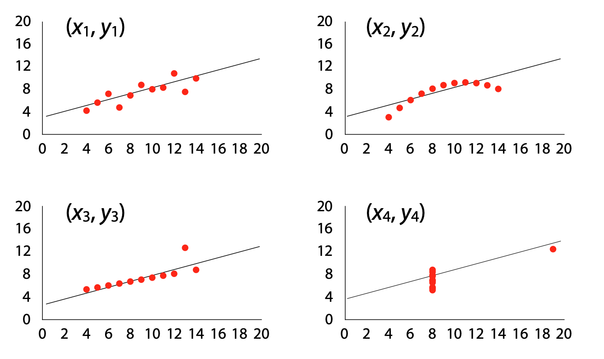
6. Figures convey information like no other medium

Slide 13
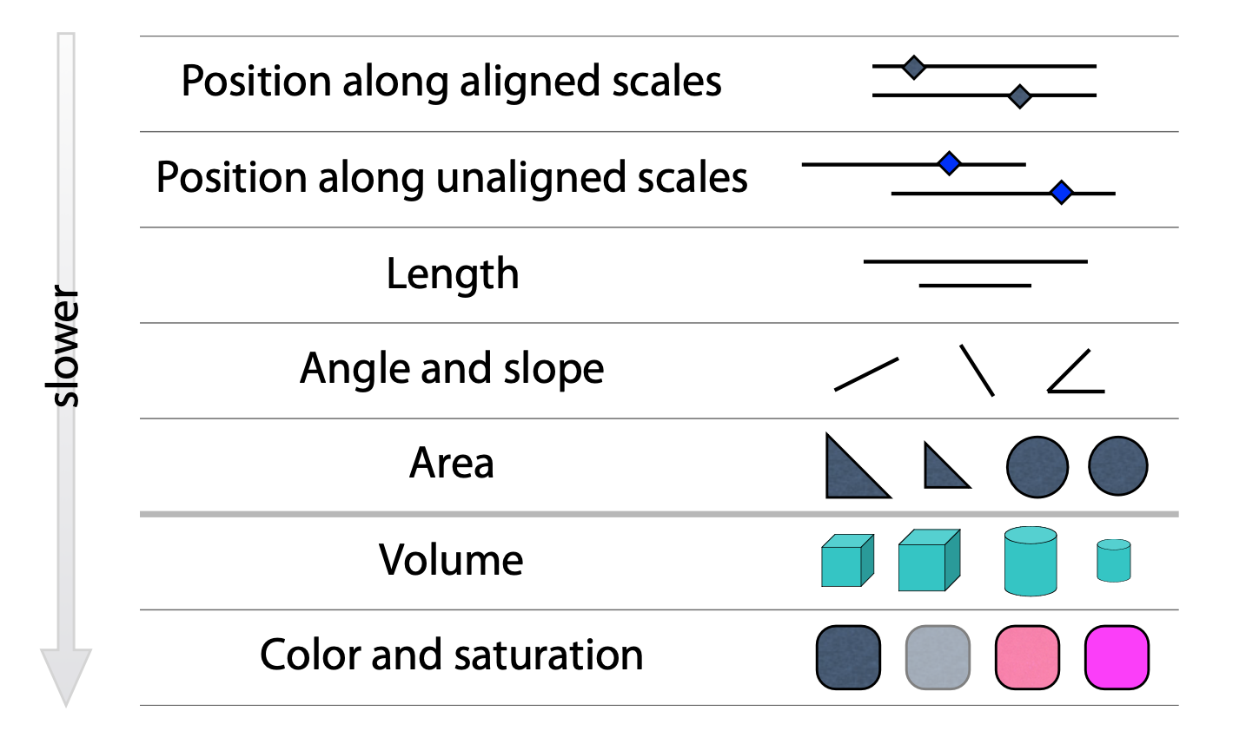
6.1. Figures: use position, color, and shapes effectively
Minimize cognitive load
Don’t use pie charts or 3D plots, please
Be thoughtful about color

Slide 14
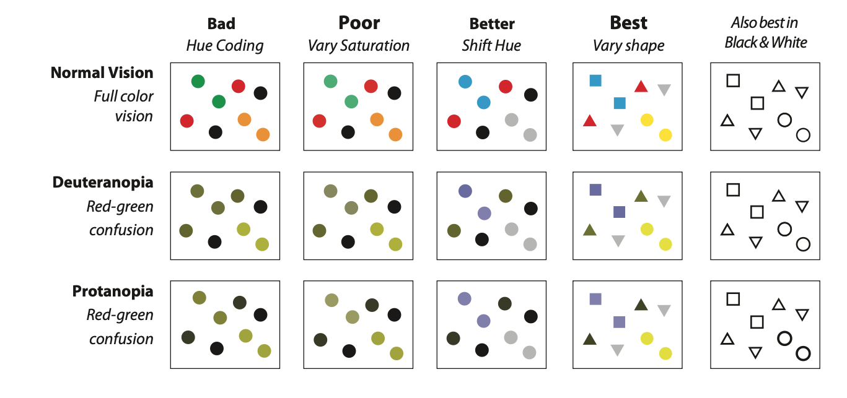
6.1. Figures: use position, color, and shapes effectively

Slide 15
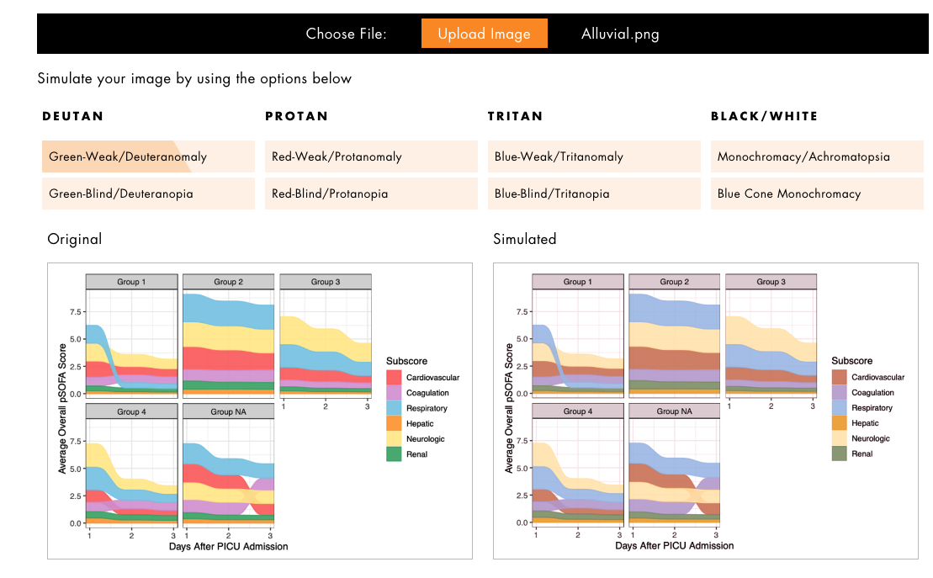
6.1. Figures: use position, color, and shapes effectively

Slide 16
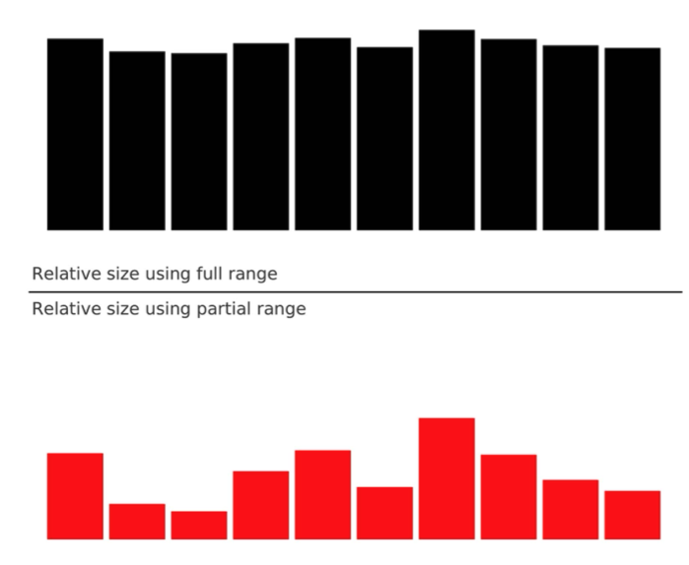
6.2. Figures: use captions and don’t mislead the reader
100
0
100
80

Slide 17
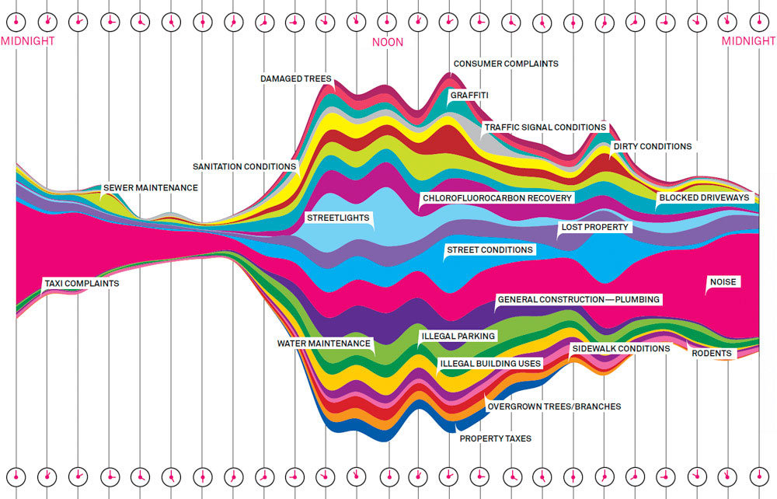
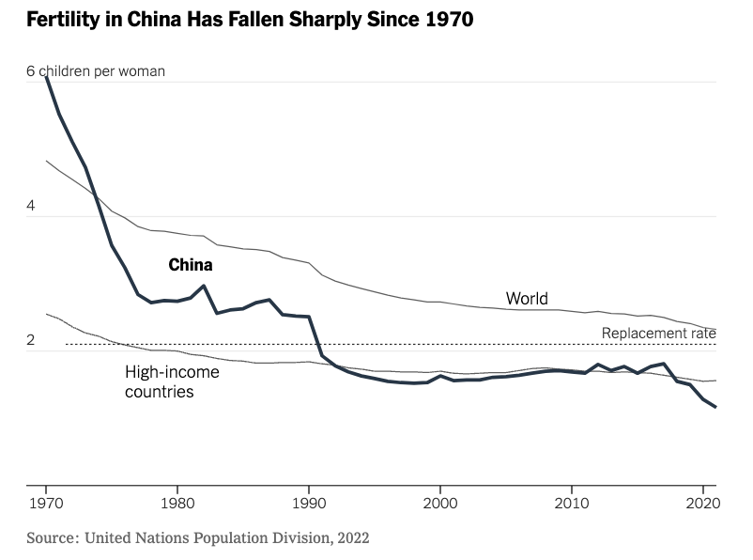
6.3. Figures: message trumps beauty

Slide 18
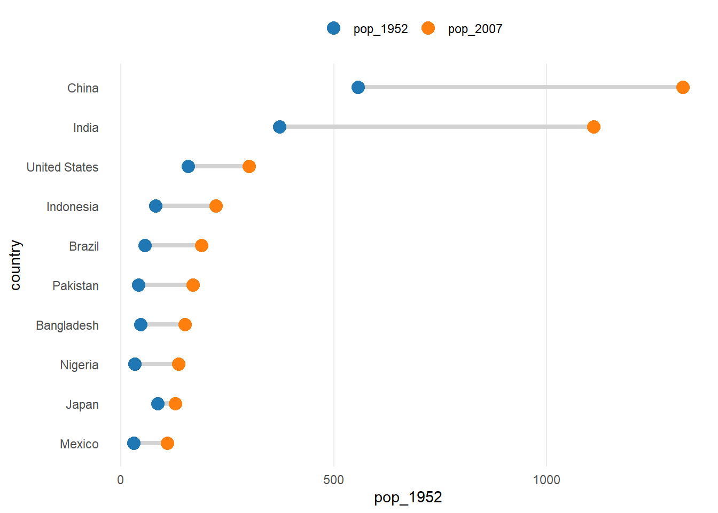
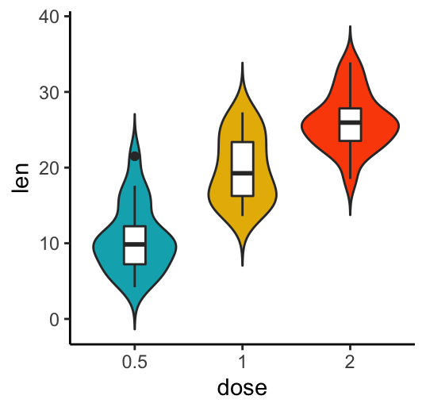
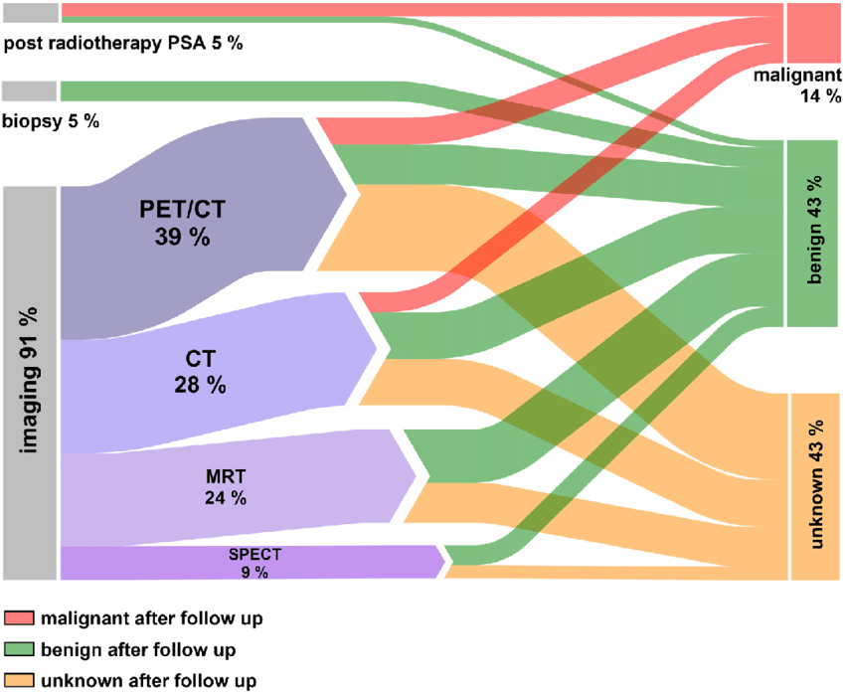
6.4. Figures: find the right figure for the right data
But don’t shy away from experimenting a bit!

Slide 19
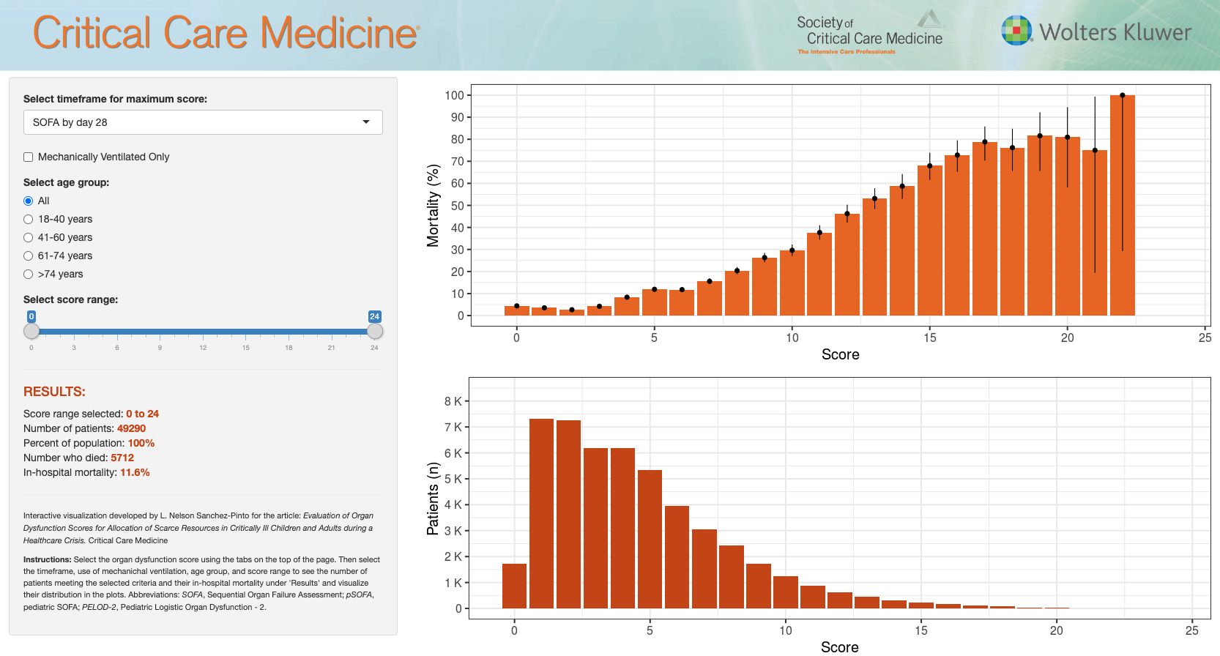

6.5. Figures: get creative!

Slide 20
Questions?
Presentation + other resources:
lsanchezpinto@luriechildrens.org

